Slide 1
جمع‌بندی مباحث شبکه بیزین
درس هوش مصنوعی دکتر جوانمردی
زمستان 1400

Slide 2
Contents
Representation
Conditional Independences
Probabilistic Inference
Enumeration (exact, exponential complexity)
Variable elimination (exact, worst-case exponential complexity, often better)
Inference is NP-complete
Sampling (approximate)

Slide 3
Uncertainty
Observed variables (evidence)
Knowledge about state of the world
Unobserved variables
Other aspects to reason about
Model
Knowledge about the relation between known variables and unknown variables

Slide 4


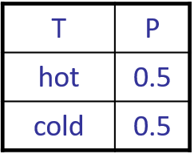
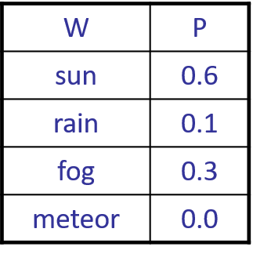


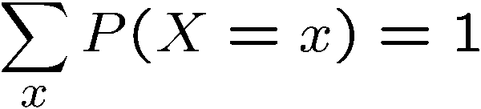
Probabilities
Random Variables: some aspect of the world about which we (may) have uncertainty
R = Is it raining? {true, false}
T = Is it hot or cold? {hot, cold}
D = How long will it take to drive to work? [0, ∞)
L = Where is the ghost? {(0,0), (0,1), …}
Probability Distributions: a TABLE of probabilities of values

Slide 5


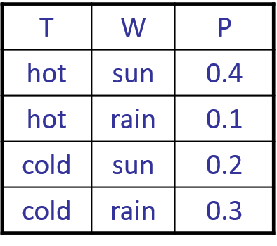

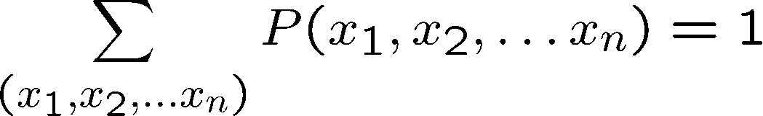
Probabilities
Joint Distributions (Probabilistic Models): over a set of random variables:

Slide 6
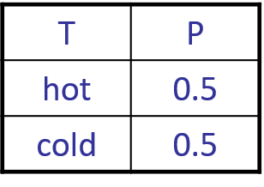
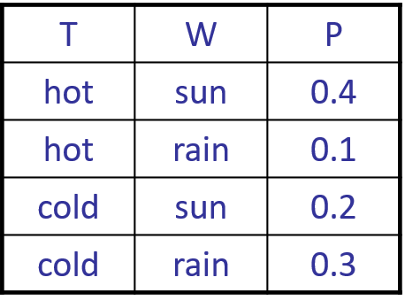
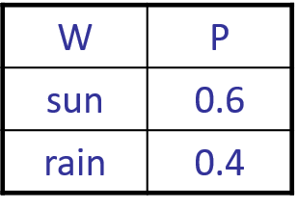
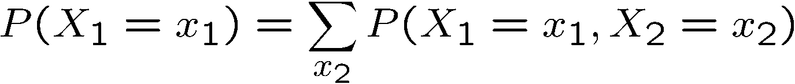
Probabilities
Marginal Distributions: sub-tables which eliminate variables
Marginalization (summing out): Combine collapsed rows by adding

Slide 7
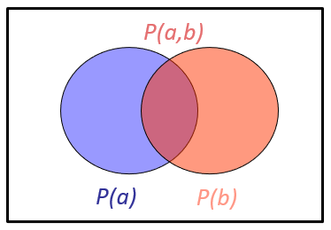
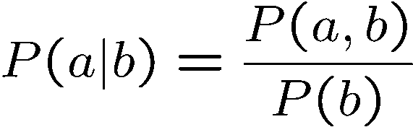
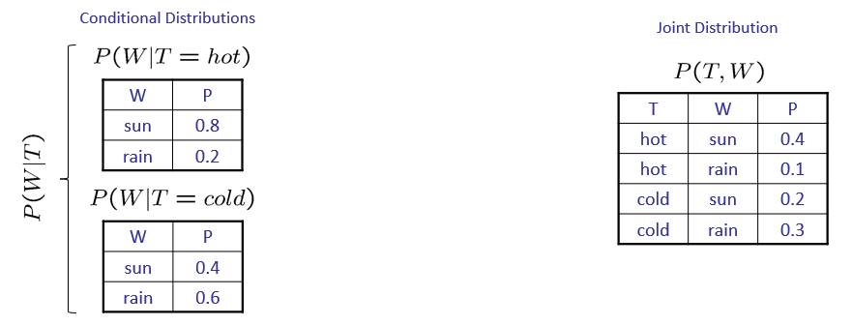
Probabilities
Conditional Probabilities
Conditional Distributions: probability distributions over some variables given fixed values of others

Slide 8
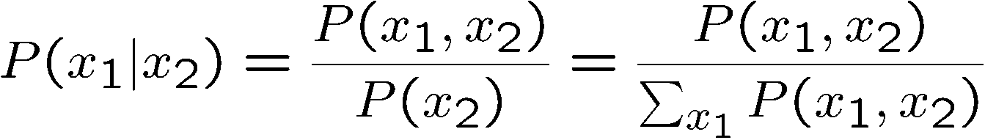
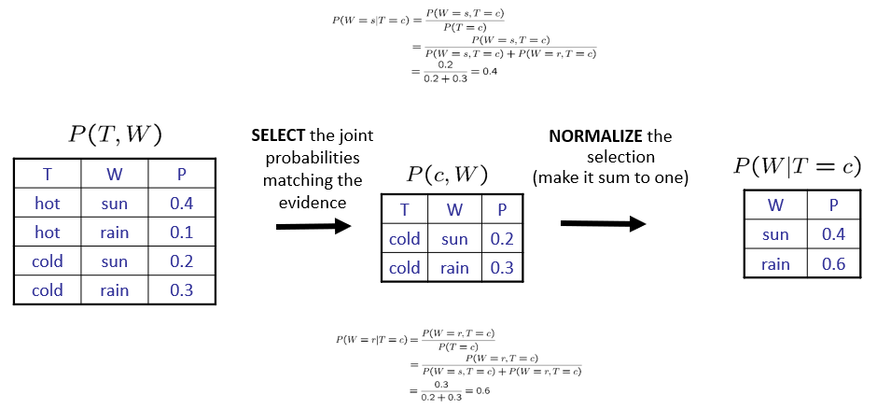
Probabilities
Normalization Trick: A trick to get a whole conditional distribution at once

Slide 9
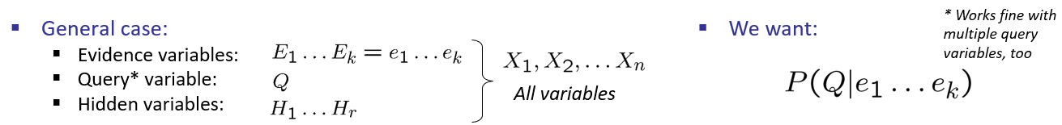
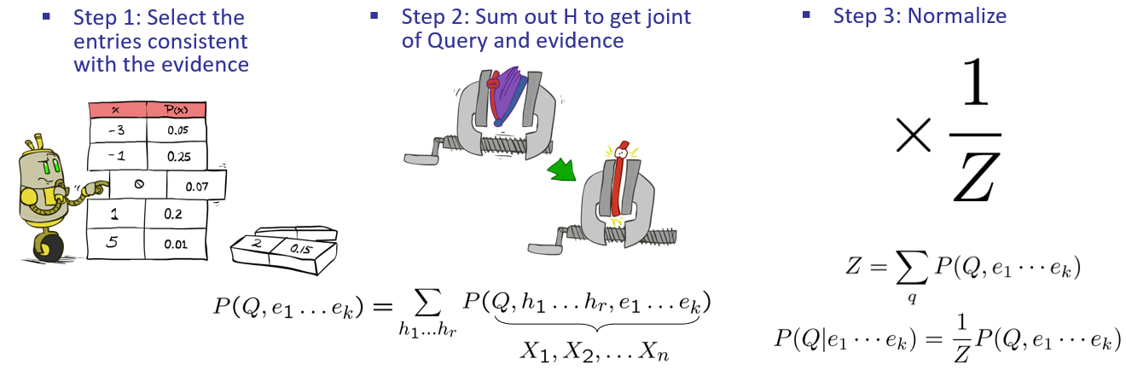
Probabilistic Inference
Compute a desired probability from other known probabilities
Inference by Enumeration
exponential complexity

Slide 10
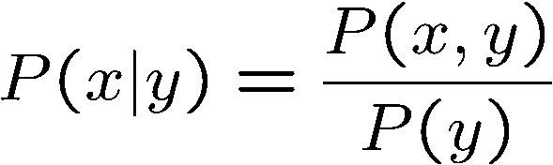
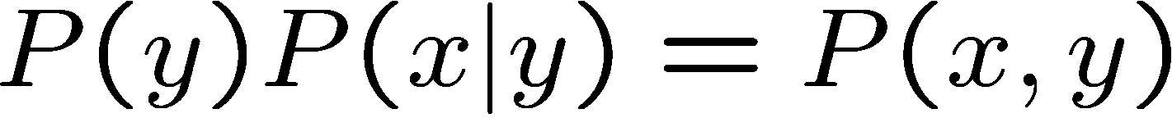
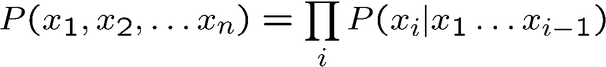
Probabilistic Rules
The Product Rule: have conditional distributions but want the joint
The Chain Rule: write any joint distribution as an incremental product of conditional distributions

Slide 11
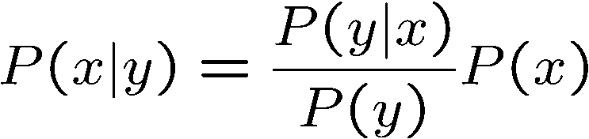
Probabilistic Rules
Bayes’ Rule: most important AI equation
Lets us build one conditional from its reverse
Often one conditional is tricky but the other one is simple

Slide 12
Probabilistic Models
Describe how (a portion of) the world works
Reason about unknown variables, given evidence
Explanation (diagnostic reasoning)
Prediction (causal reasoning)
Simplifications
May not account for every variable
May not account for all interactions between variables

Slide 13

Independence
Two variables are independent if:
Their joint distribution factors into a product of two simpler distributions
Independence is a simplifying modeling assumption
Unconditional (absolute) independence is very rare

Slide 14


Conditional Independence
Our most basic and robust form of knowledge about uncertain environments
X is conditionally independent of Y given Z:
Simplifying the Chain Rule
Bayes’nets / graphical models help us express conditional independence assumptions

Slide 15
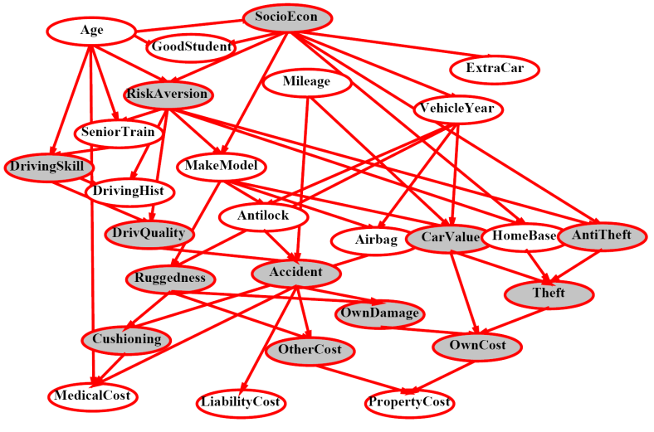
Bayes’ Nets
Problems with using full joint distribution
Unless there are only a few variables, the joint is WAY too big to represent explicitly
Hard to learn (estimate) anything empirically about more than a few variables at a time
Describing complex joint distributions (models) using simple, local (conditional) distributions
Called graphical models
Local interactions chain together to give global, indirect interactions

Slide 16
Graphical Model Notation
Nodes: variables (with domains)
Can be assigned (observed) or unassigned (unobserved)
Arcs: interactions
Indicate “direct influence” between variables
Encode conditional independence

Slide 17

Bayes' Net Semantics
A set of nodes, one per variable X
A directed, acyclic graph
A conditional distribution for each node
CPT: conditional probability table
A Bayes net = Topology (graph) + Local Conditional Probabilities
A₁
A_{n}
X

Slide 18
Probabilities in BNs
Bayes’ nets implicitly encode joint distributions
As a product of local conditional distributions
To see what probability a BN gives to a full assignment, multiply all the relevant conditionals together:
Not every BN can represent every joint distribution
The topology enforces certain conditional independencies

Slide 19
Causality
Bayes’ nets reflecting the true causal patterns
Often simpler (nodes have fewer parents)
Often easier to think about
Often easier to elicit from experts
BNs need not actually be causal
Sometimes no causal net exists over the domain (especially if variables are missing)
End up with arrows that reflect correlation, not causation
Topology really encodes conditional independence

Slide 20
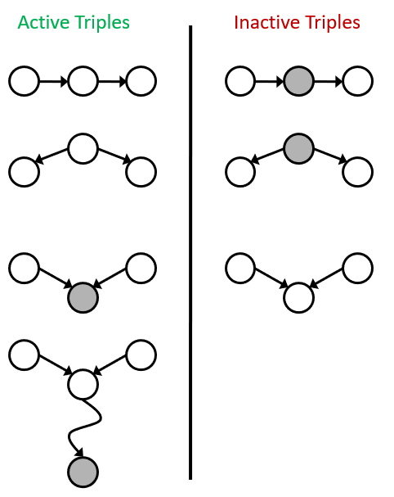
Bayes Nets: Assumptions
Assumptions we are required to make to define the Bayes net when given the graph:
D-separation Algorithm
Causal Chains
Common Cause
Common Effect

Slide 21
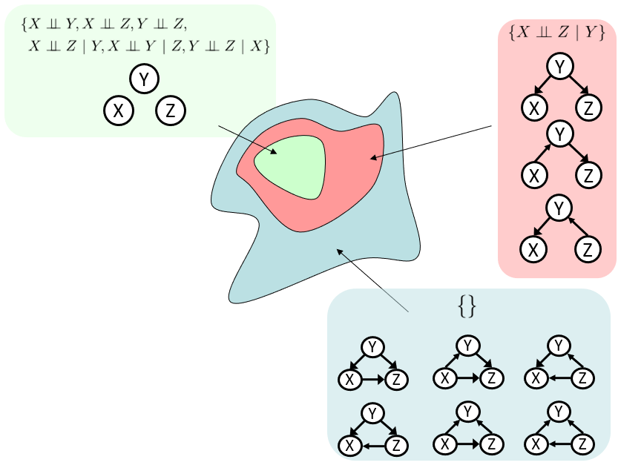
Bayes Nets: Assumptions
X and Y are conditionally independent given evidence variables {Z} if
X and Y “d-separated” by Z
No active path between X and Y
A path is active if
Each triple is active
All it takes to block a path is a single inactive segment
Structure Implications
D-separation gives precise conditional independence guarantees from BN graph structure
Determines the set of probability distributions that can be represented

Slide 22
Inference
Calculating some useful quantity from a joint probability distribution
Posterior probability:
Most likely explanation:
Inference by Enumeration: Select, Join, Sum out, Normalize
Join up the whole joint distribution before sum out the hidden variables
So slow
Variable Elimination
Interleave joining and marginalizing
Still NP-hard, but usually much faster than inference by enumeration

Slide 23








Factors
T | W | P
hot | sun | 0.4
hot | rain | 0.1
cold | sun | 0.2
cold | rain | 0.3
T | W | P
cold | sun | 0.2
cold | rain | 0.3
Joint distribution: P(X,Y)
Selected joint: P(x,Y)
Single conditional: P(Y | x)
Family of conditionals: P(Y | X)
Specified family: P(y | X)
T | W | P
cold | sun | 0.4
cold | rain | 0.6
T | W | P
hot | sun | 0.8
hot | rain | 0.2
cold | sun | 0.4
cold | rain | 0.6
T | W | P
hot | rain | 0.2
cold | rain | 0.6

Slide 24
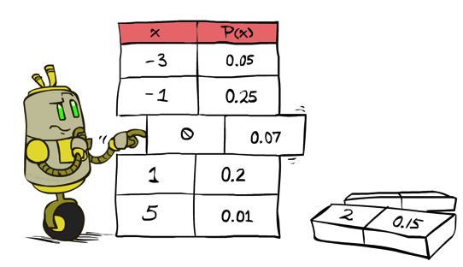
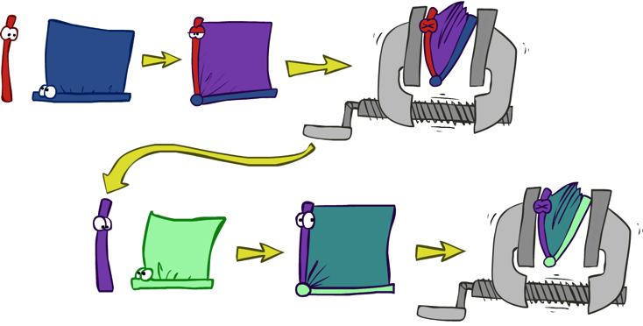


Variable Elimination
Start with initial factors: Local CPTs (but instantiated by evidence)
While there are still hidden variables (not Q or evidence)
Pick a hidden variable H
Join all factors mentioning H
Eliminate (sum out) H
Join all remaining factors and normalize

Slide 25



Example: Traffic Domain
Random Variables
R: Raining
T: Traffic
L: Late for class!
+r | 0.1
-r | 0.9
R
T
+r | +t | 0.8
+r | -t | 0.2
-r | +t | 0.1
-r | -t | 0.9
L
+t | +l | 0.3
+t | -l | 0.7
-t | +l | 0.1
-t | -l | 0.9

Slide 26
Example: Traffic Domain
+r | 0.1
-r | 0.9
+r | +t | 0.8
+r | -t | 0.2
-r | +t | 0.1
-r | -t | 0.9
+t | +l | 0.3
+t | -l | 0.7
-t | +l | 0.1
-t | -l | 0.9

Slide 27
Variable Elimination
Computational and Space Complexity
Is determined by the largest factor
The elimination ordering can greatly affect the size of the largest factor generated in the process
Inference in Bayes’ nets is NP-hard. No known efficient probabilistic inference in general
For poly-trees you can always find an ordering that is efficient

Slide 28
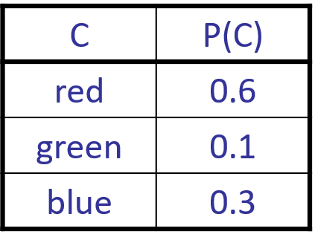
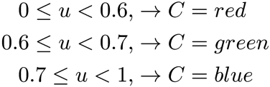
Sampling
Like repeated simulation
Learning: get samples from a distribution you don’t know
Inference: getting a sample is faster than computing the right answer
Sampling from given distribution
Step 1: Get sample u from uniform distribution over [0, 1)
Step 2: Convert this sample u into an outcome for the given distribution

Slide 29
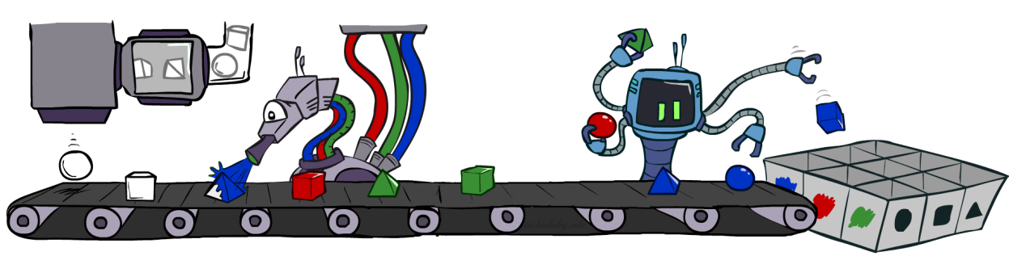
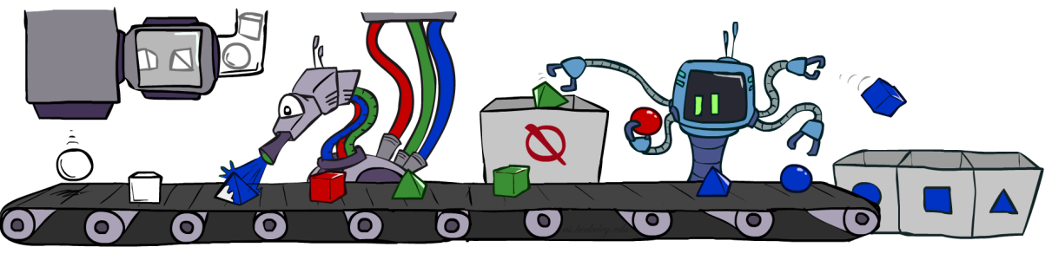

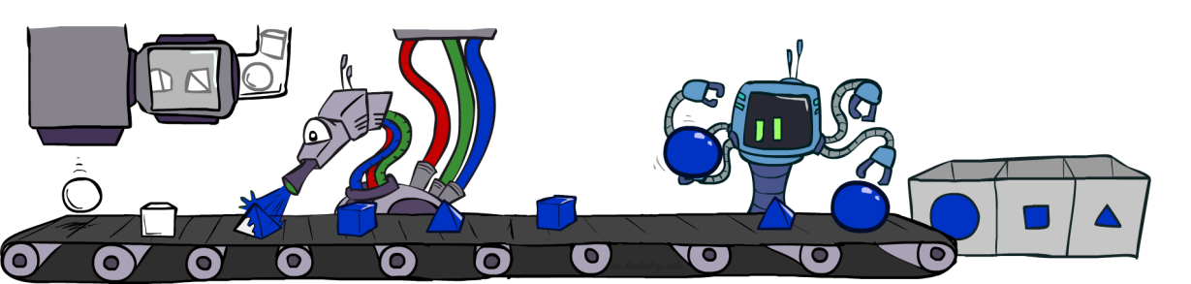
Sampling in Bayes’ Nets
Prior Sampling
Rejection Sampling
Likelihood Weighting
Gibbs Sampling

Slide 30
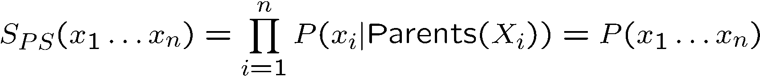

Prior Sampling
For i = 1, 2, …, n
Sample x_{i} from P(X_{i} | Parents(X_{i}))
Return (x₁, x₂, …, x_{n})

Slide 31

Rejection Sampling
Input: evidence instantiation
For i = 1, 2, …, n
Sample x_{i} from P(X_{i} | Parents(X_{i}))
If x_{i} not consistent with evidence
Reject: return – no sample is generated in this cycle
Return (x₁, x₂, …, x_{n})
Ignore (reject) samples if not consistent with evidence
If evidence is unlikely, rejects lots of samples
Evidence not exploited as you sample

Slide 32
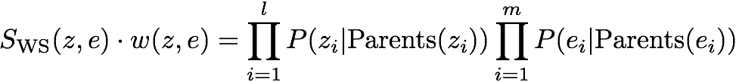

Likelihood Weighting
Input: evidence instantiation
w = 1.0
for i = 1, 2, …, n
if X_{i} is an evidence variable
X_{i} = observation x_{i} for X_{i}
Set w = w * P(x_{i} | Parents(X_{i}))
else
Sample x_{i} from P(X_{i} | Parents(X_{i}))
return (x₁, x₂, …, x_{n}), w
Fix evidence variables and sample the rest
Weight by probability of evidence given parents
Takes evidence into account as we generate the sample
More of the samples will reflect the state of the world suggested by the evidence

Slide 33

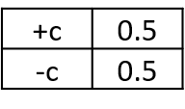


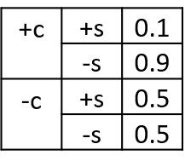
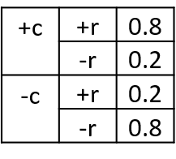

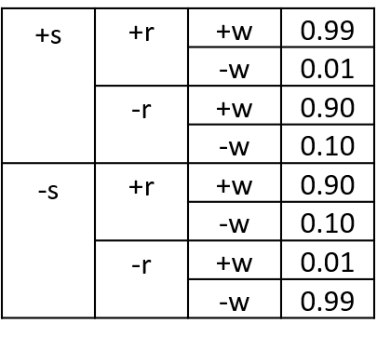

Example
Samples:
$$P\left(C | +w\right)=?$$
+c, +s, +r, +w
-c, -s, -r, +w
+c, -s, -r, +w
+c, -s, +r, +w
Cloudy
Cloudy
-c, -s, -r, +w
Sprinkler
Sprinkler
Rain
Rain
WetGrass
WetGrass

Slide 34

Likelihood Weighting
Evidence influences the choice of downstream variables, but not upstream ones
Weights can sometimes be very small
Sum of weights over all samples is indicative of how many “effective” samples were obtained

Slide 35

Gibbs Sampling
Start with an arbitrary instantiation consistent with the evidence
Resample one variable at a time, conditioned on all the rest, but keep evidence fixed
Produces sample from the query distribution P( Q | e ) in limit of re-sampling infinitely often
Both upstream and downstream variables condition on evidence

Slide 36
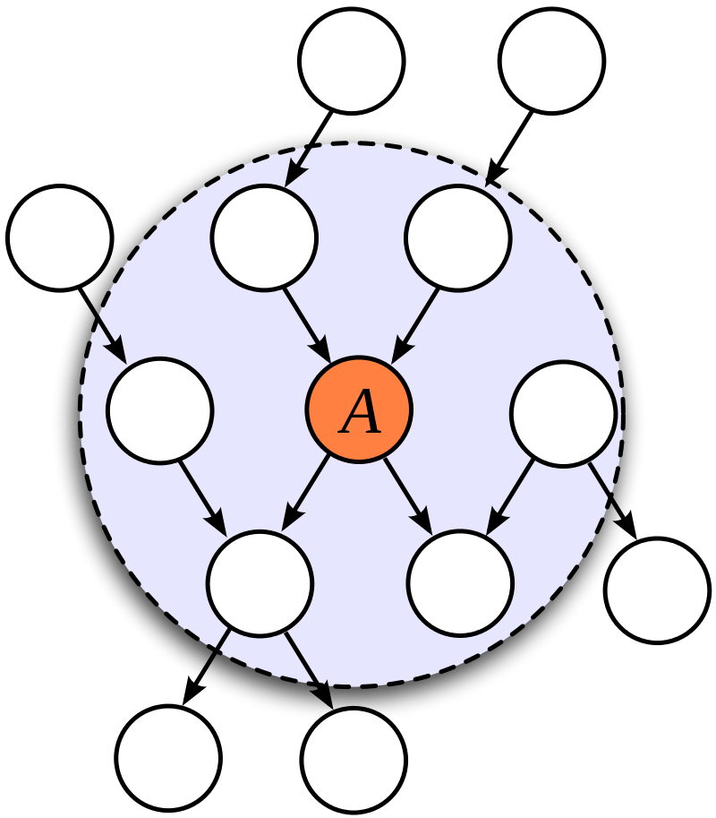
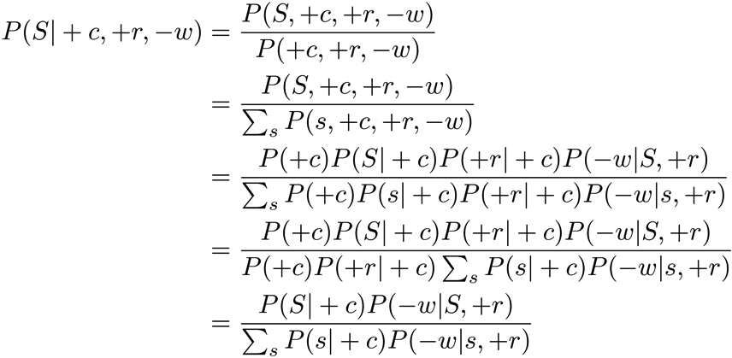
Gibbs Sampling
C
S
+r
W
Efficient Resampling of One Variable
Usually much easier than sampling from the full joint distribution
Only requires a join on the variable to be sampled
The resulting factor only depends on the variable’s parents, its children, and its children’s parents
This is often referred to as its Markov blanket

